Slide 1
Topic 8
Software Testing
Part 2

Slide 2
Structural Testing
• aka Path Analysis
• a white-box or glass-box testing technique
– we are looking at the code
• Is the program (ie. test suite) “hitting” every path of execution

Slide 3
Structural Testing
• Levels of code coverage
– C₀ à→ Statement/Line coverage
– C₁ à→ Branch coverage
– C₂ à→ Condition coverage
– C₃ à→ Multiple condition coverage
– C₄ à→ Path coverage

Slide 4
Statement Coverage
public static String classify(int x) {
boolean pos = true;
boolean even = true;
if (x > 0)
pos = true;
if (x % 2 == 0)
even = true;
return String.format("Number:%1$d,
Positive:%2$b,Even:%3$b", x, pos, even);
}
String returned should contain:
-­‐ “Positve:true” if the number is positve, “:false” otherwise
-­‐ “Even:true” if the number is even, “:false” otherwise

Slide 5
Statement Coverage
@Test
public void testClassify() {
String result = Ex1.classify(2); assertThat(result,
containsString("Positive:true")); assertThat(result, containsString("Even:true"));
}
Choose test case for value 2
Will this pass? Yes.
What about for value 3?

Slide 6
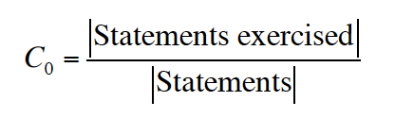
Statement Coverage
Strategy: find paths that cover all statements; write test cases to exercise those paths
• Test suite should have C₀= 1 (ie. 100%)
• Least restrictive of the coverage criteria
– Some branches may be missed
• Helps measure correctness of code written
– Better than nothing

Slide 7
Structural Testing
• But, structural testing is not functional testing…
• The method is not correct
– still need to test correct functionality

Slide 8
Program Flowcharts
• Labelled, directed graph, where
– statements are represented by rectangle nodes
– decisions are represented by diamond nodes

Slide 9
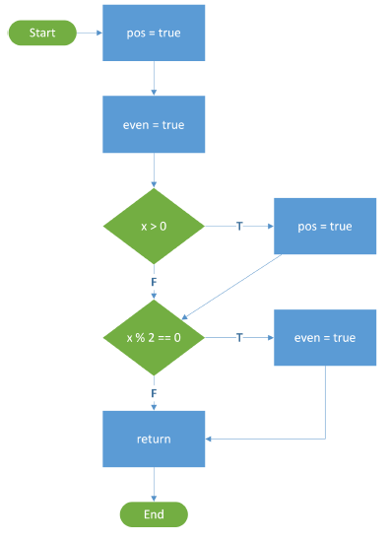
Program Flowcharts
• Nodes
– statements
• Edges
– indicate parts of paths which may be followed through the code
• Labels on edges
– indicate flow direction when a condition is true(T) vs false(F)

Slide 10
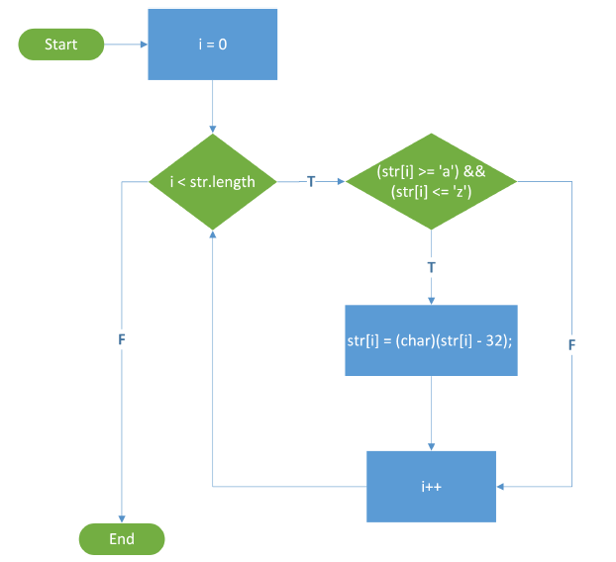
Program Flowcharts

Slide 11
Structural Testing
• If our test suite executes all statements, has visited every node in the flowchart
– test suite achieves full/100% node coverage or covered every node
• (equivalent to statement coverage)
• Note: Statement = Line Coverage
– Any line containing code is measured
• Considered covered if any code on the line is executed
– Not exactly the same thing as statement coverage
• Can have more than one statement per line
– Most people mean statement coverage when they say line coverage

Slide 12
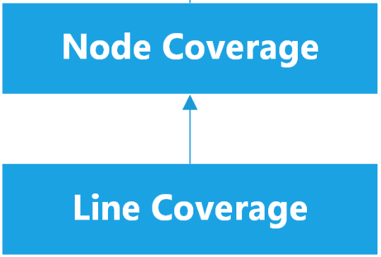
Structural Testing
100% node coverage implies 100% line coverage
– The converse is not true:
• 100% line coverage does not imply 100% node coverage
Node (statement) coverage is stronger than line coverage

Slide 13
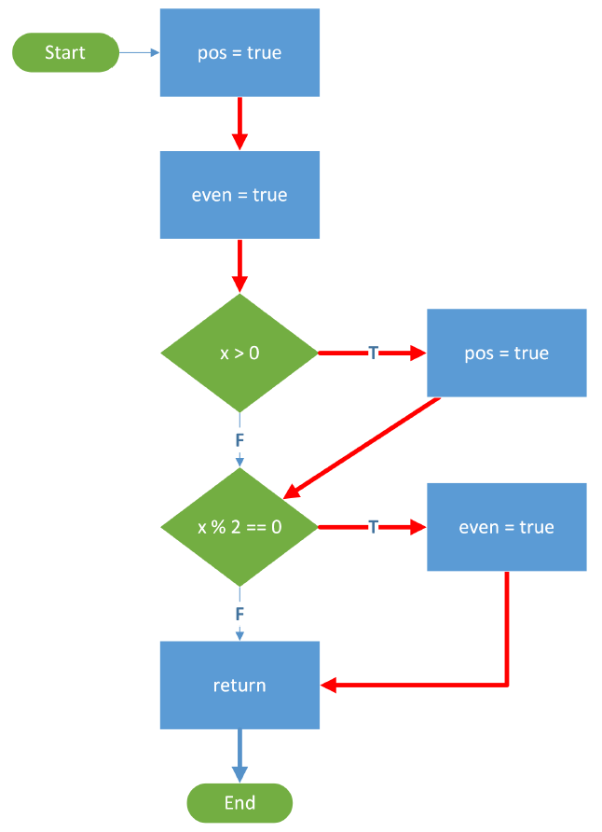
Example
• Consider the first example flowchart
– Test case: x = 2
– All nodes visited
• 100% statement coverage
– However, neither F branch has ever been taken

Slide 14
Edge Coverage
• If our test suite follows every edge in the flowchart
– We say that the test suite covers every edge
– We can also say that it covers every decision (or branch)
• Branch coverage:
– Has every branch of each control structure (if, switch) been executed?
– Equivalently, has every edge in the program flowchart been executed?

Slide 15
Edge Coverage
• More thorough than statement coverage
– Catches more problems
• Example:
– We had 100% statement coverage for the first flowchart, but the bug was not detected
– Would we have detected the bug if we followed every edge? Let’s write some tests and see.

Slide 16
Edge Coverage
@Test
public void testClassifyPositiveEven() {
String result = Ex1.classify(2);
assertThat(result,
containsString("Positive:true")); assertThat(result,
containsString("Even:true"));
}
@Test
public void testClassifyNegativeOdd() { String result = Ex1.classify(-1);
assertThat(result,
containsString("Positive:false")); assertThat(result,
containsString("Even:false"));
}

Slide 17
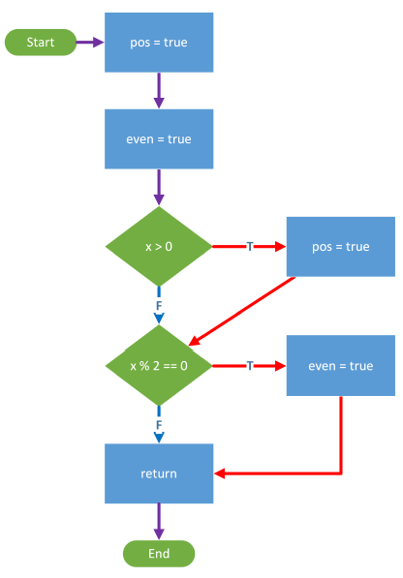
Edge Coverage
• We’ll test with the following test cases:
– x = 2
– x = -1
– A purple edge indicates an edge followed by both test cases
• This test suite will give
us 100% edge coverage.

Slide 18
Coverage Terminology
• If a test suite executes 100% of all statements, we say it achieves 100% node coverage (or statement coverage)
• If a test suite follows 90% of all edges, we say it achieves 90% edge coverage

Slide 19
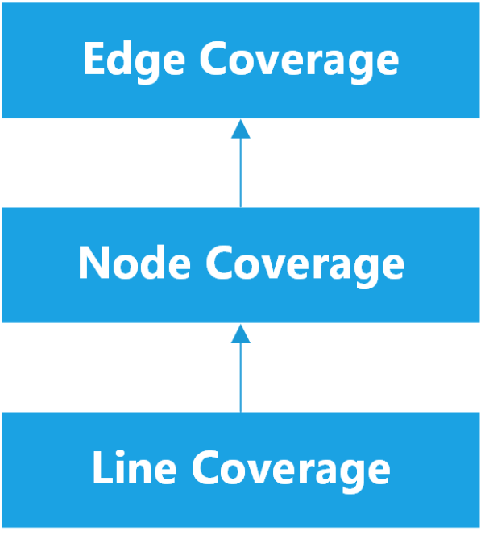
Edge Coverage
100% edge coverage implies 100% node coverage
– If we followed every edge, we must have visited every node
– The converse is not true:
• 100% node coverage does not imply 100% edge coverage
Edge coverage is stronger
than node coverage

Slide 20
Minimal Test Suites
• More test cases = higher coverage
– Larger test suites take longer to run
– Often want to find some minimal test suite
• Which still achieves 100% coverage
– Important to define what minimal means
• Minimal test cases?
• Minimal number of inputs used?
• Minimal time to run?

Slide 21
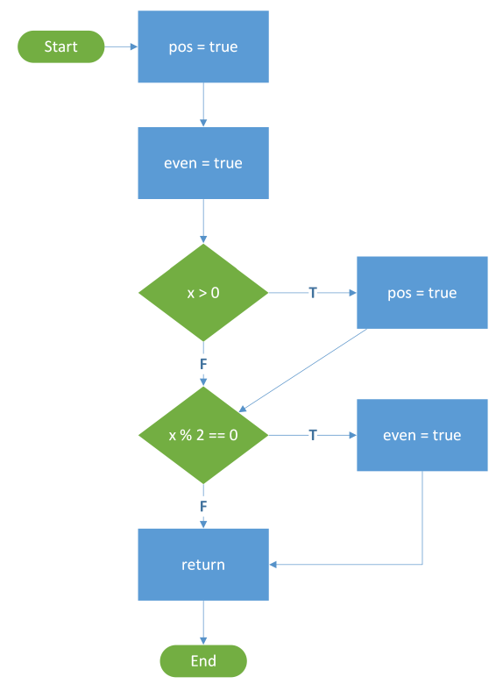
Minimal Test Suites Example
Suppose we want 100% edge coverage
– Test suite: x = 2, x = 1, x = -2
• Requires 3 test cases
– Test suite: x = 2, x = -1
• Requires only 2 test cases
• Not possible to have smaller test suite, with only 1 test case
– Must cover both decisions T and F edges
• x = 2, x = -1 is a minimal test suite for 100% edge coverage
– in the sense of needing the fewest test cases

Slide 22
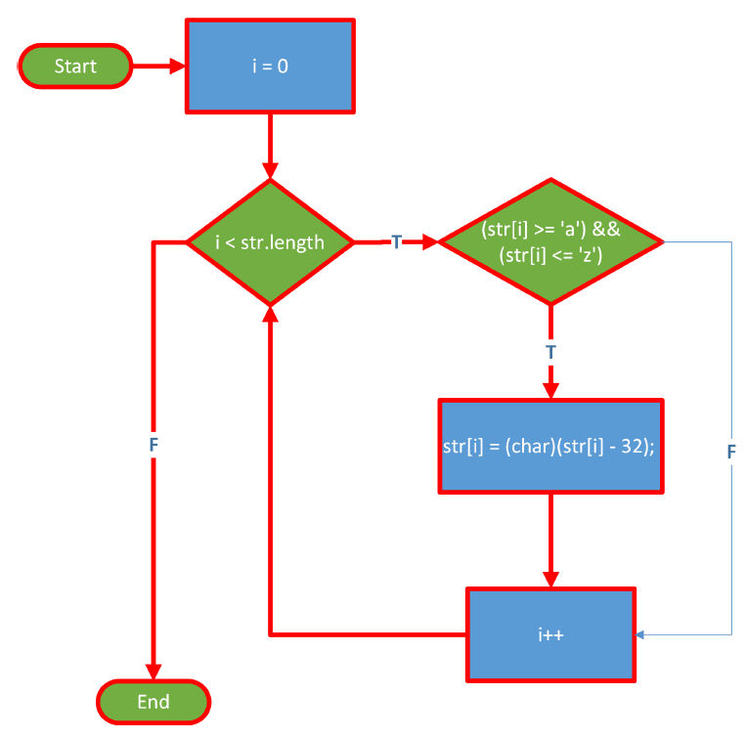
Minimal Test Suites Example
100% node coverage:
1) {‘a’}
- but F branch of the inner condition is not taken
100% edge coverage:
1) {‘a’} {‘X’}
2) {‘a’, ‘X’}

Slide 23
Minimal Test Suites
• Which of (1) and (2) is minimal for edge coverage?
– Depends on how we define minimality
• (1) has 2 tests, but each has just 1 character
• (2) has just 1 test, but it has 2 characters

Slide 24
Minimal Test Suites
• minimality for a test suite should always be defined
– Here, it makes more sense to accept (2) as minimal
– Fewer test cases = faster execution of the test suite
• For this problem, we could say that:
– Test suite X is more minimal than test suite Y if either:
• X has fewer test cases than Y; or
• X has the same number of test cases as Y, but the total number of characters in X is less than in Y
– Saves us from accepting {‘a’, ‘a’, ‘a’, ‘X’, ‘X’, ‘X’} as minimal

Slide 25
Condition Coverage
• Decision: everything in parentheses after the if, while
– e.g. ((str[i] >= 'a') && (str[i] <= 'z'))
• Condition: the individual terms of the decision
– e.g (str[i] >= 'a'), (str[i] <= 'z')
• are the two conditions
• So far, we've written each decision in a single diamond.
• If we divide the conditions within each decision into separate diamonds, we can get a better reflection of what the program does.

Slide 26
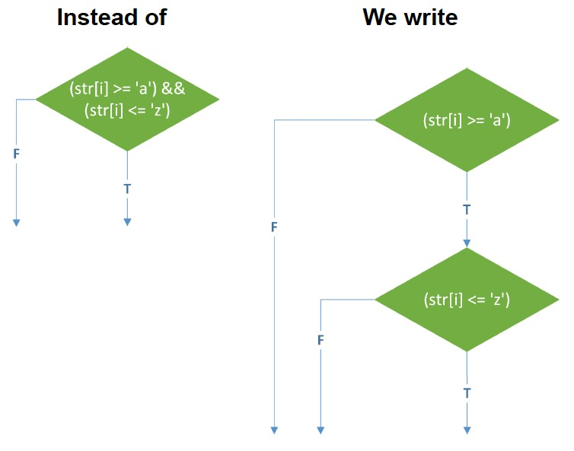
Flowcharts: Splitting up Decisions
Recall: Java shortcircuits logical operators && and ||
• Boolean expression evaluation stops as soon as final result can be determined
We now have two new edges that we'll need to cover

Slide 27
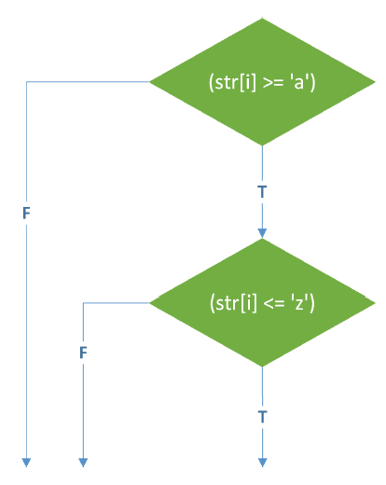
Condition Coverage
We split up all diamonds and then cover all edges
How many characters will be needed in our test input to achieve 100% condition coverage?

Slide 28
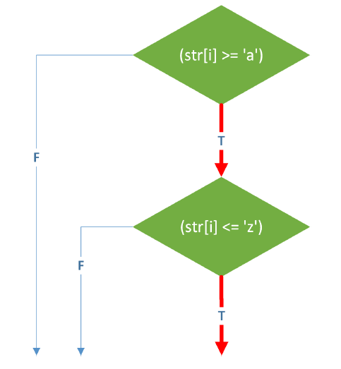
Condition Coverage
• Test Case
– {‘a’}

Slide 29
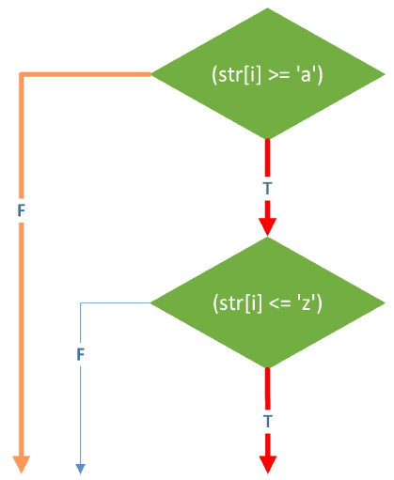
Condition Coverage
• Test Case
– {‘a’, ‘X’}

Slide 30
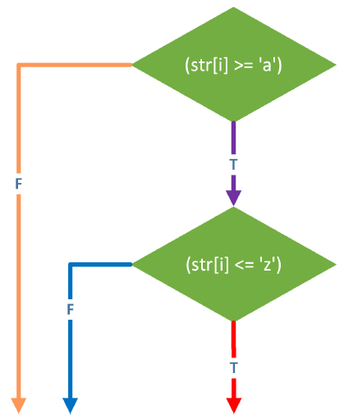
Condition Coverage
To evaluate the second F edge, we simply need a character that is >= ‘a’ and also > ‘z’
• Test Case
– {‘a’, ‘X’, ‘~’}
• This test case achieves 100% condition coverage

Slide 31
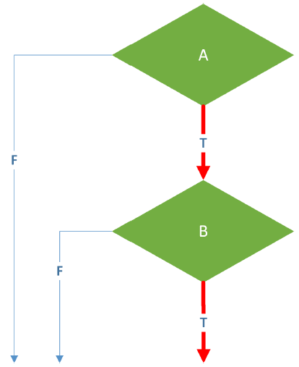
Condition Coverage - A && B
In general, to achieve condition coverage for a decision A && B, we need to design test cases so that:
• | A | = | true, B = true
• | A | = | true, B = false
• | A | = | false

Slide 32
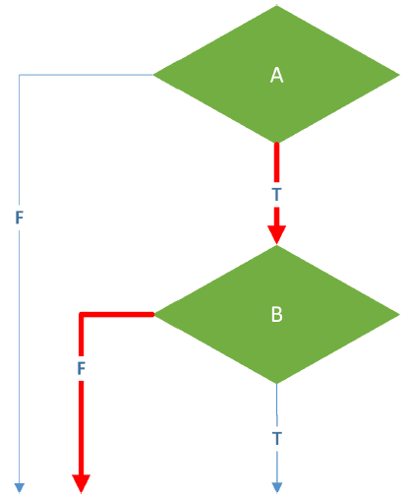
Condition Coverage - A && B
In general, to achieve condition coverage for a decision A && B, we need to design test cases so that:
• | A | = | true, B = true
• | A | = | true, B = false
• | A | = | false

Slide 33
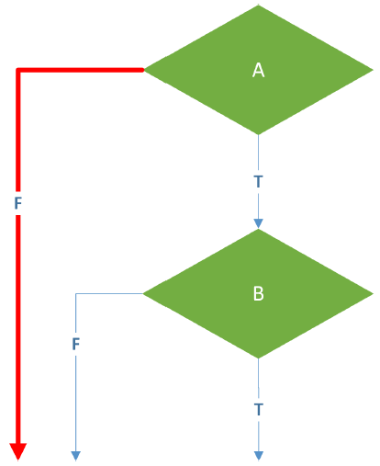
Condition Coverage - A && B
In general, to achieve condition coverage for a decision A && B, we need to design test cases so that:
• | A | = | true, | B | = | true
• • | A A | = = | true, false | B | = | false
Unless A is true, B won’t be
evaluated, due to short-circuit evaluation

Slide 34
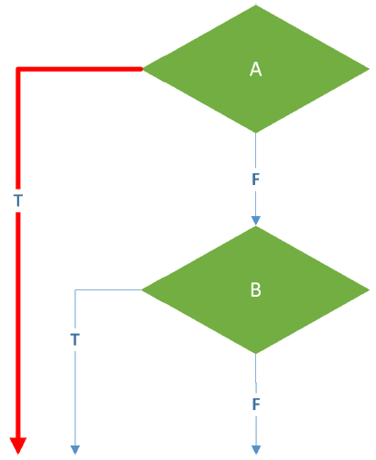
Condition Coverage - A || B
In general, to achieve condition coverage for a decision A || B, we need to design test cases so that:
• | A | = | true
• | A | = | false, | B = true
• | A | = | false, | B = false
Unless A is false, B won’t be
evaluated, due to short-circuit evaluation

Slide 35

Condition Coverage - A || B
In general, to achieve condition coverage for a decision A || B, we need to design test cases so that:
• | A | = | true
• | A | = | false, B = true
• | A | = | false, B = false

Slide 36
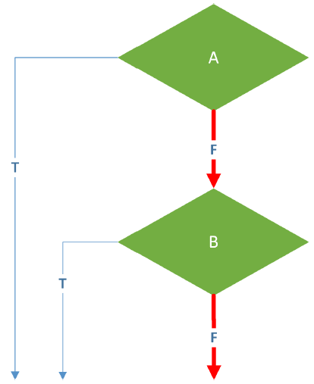
Condition Coverage - A || B
In general, to achieve condition coverage for a decision A || B, we need to design test cases so that:
• | A | = | true
• | A | = | false, B = true
• | A | = | false, B = false

Slide 37
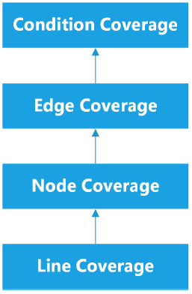
Condition Coverage
If we have 100% condition coverage
• We must have evaluated each condition of an if, while, etc. both ways
• Therefore, we must have evaluated each decision both ways
Thus, condition coverage is stronger than edge (decision) coverage
Notes:
Stronger than edge coverage only because we specifically separated conditional statements, Boolean expressions, etc. into separate nodes. Each condition gets its own node, and has its own branches.

Slide 38
Example: Condition Coverage
Consider the following Boolean expression:
( ((x == 0) || (y > 4)) && ((z < 10) || (w == 0)) )
For brevity, let
A : | (x | == 0)
B : | (y | > 4)
C : | (z | < 10)
D : | (w | == 0)
Expression above is equivalent to:
( ( A || B ) && ( C || D ) )

Slide 39
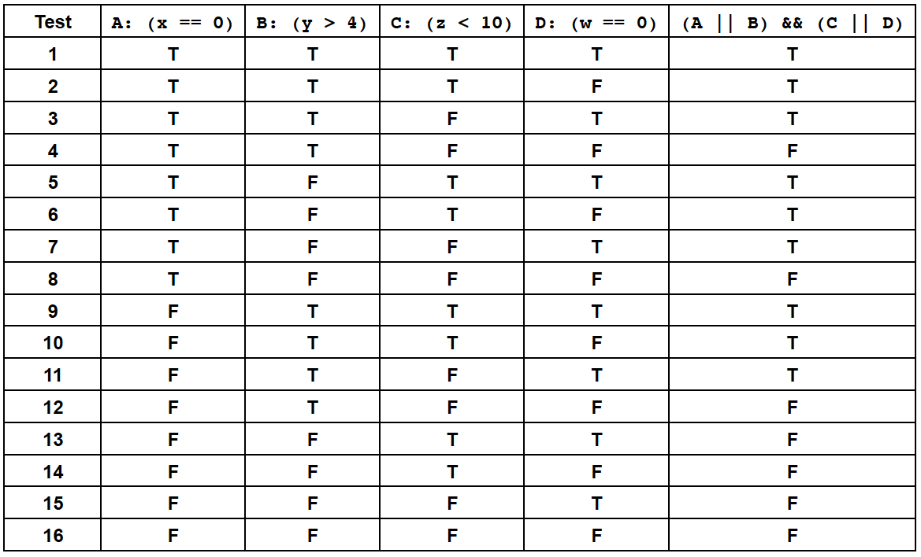
Example: Condition Coverage

Slide 40
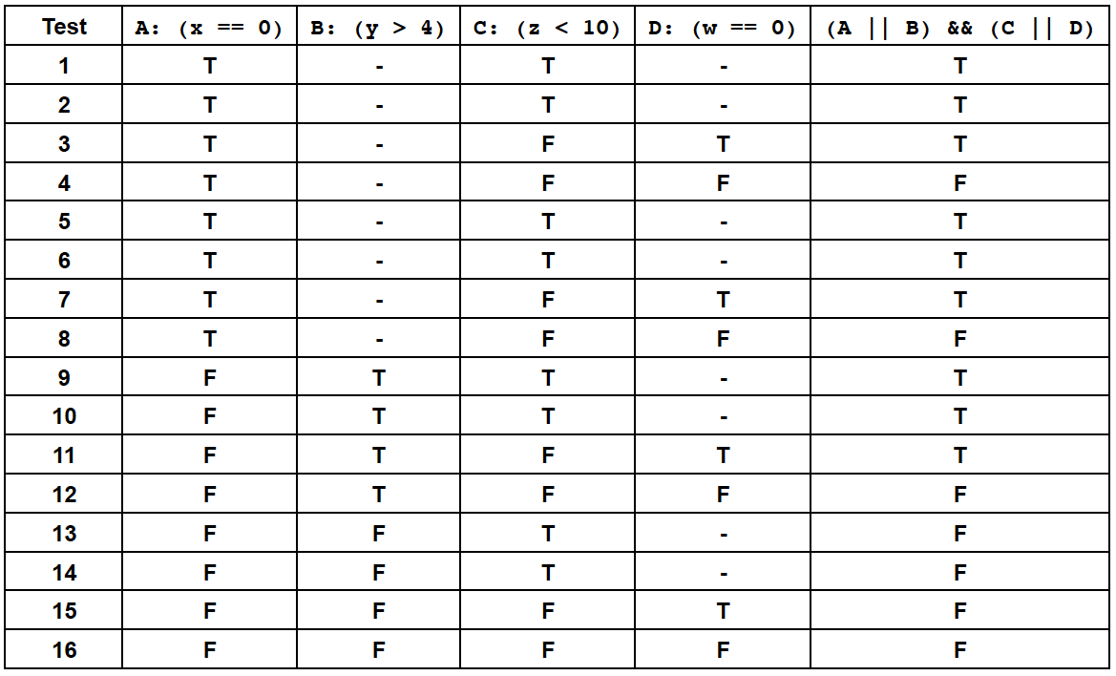
Example: Condition Coverage

Slide 41
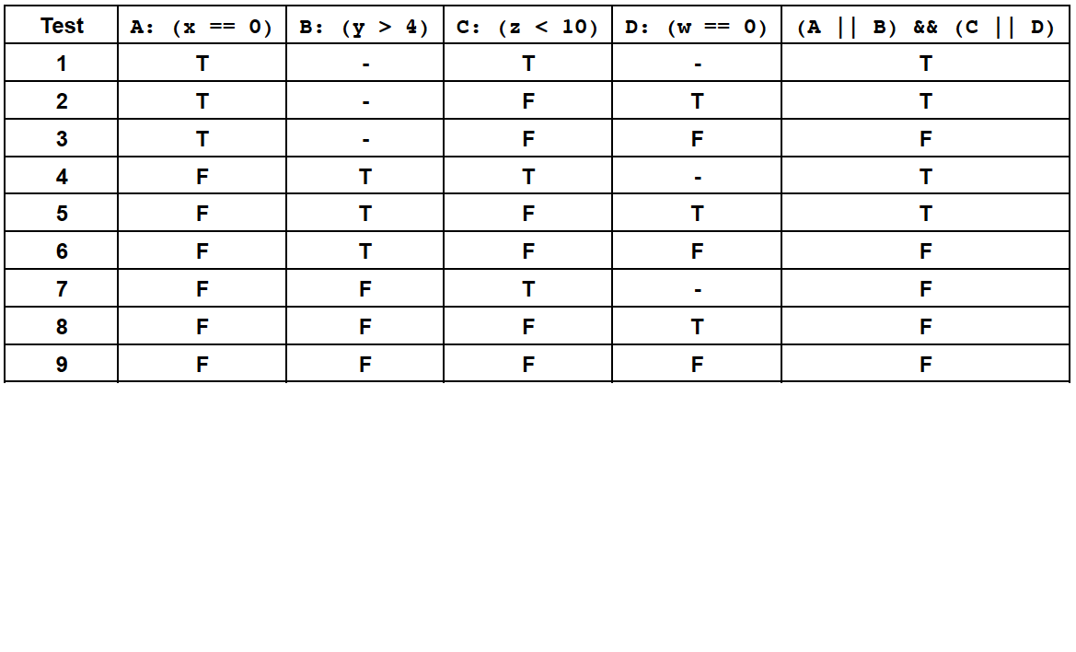
Example: Condition Coverage

Slide 42
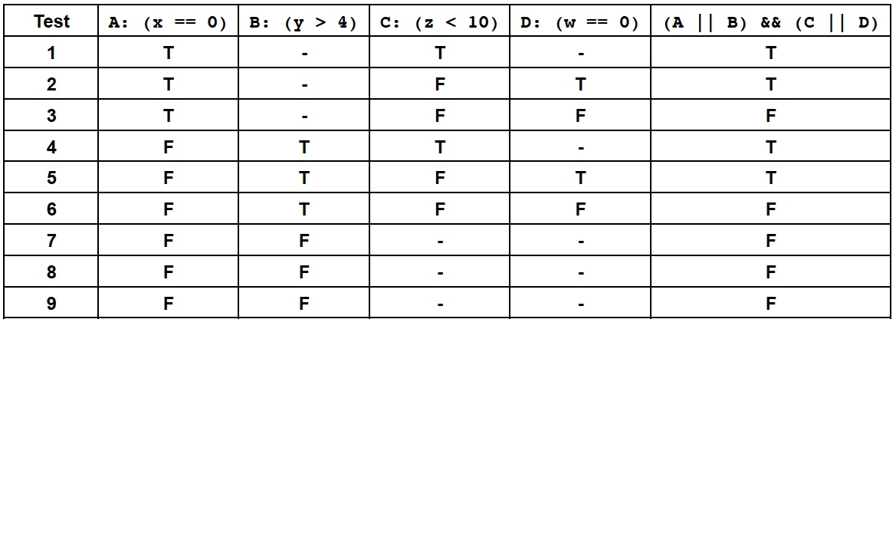
Example: Condition Coverage

Slide 43
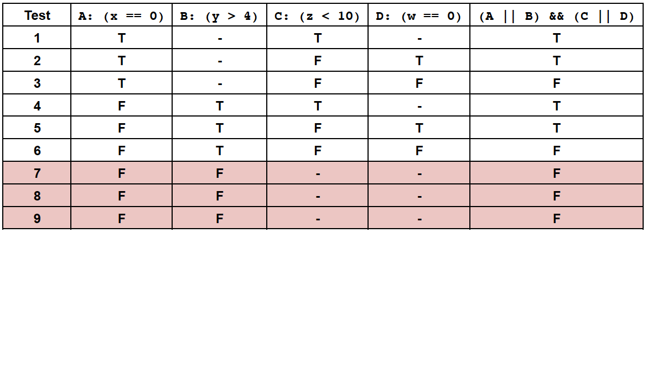
Example: Condition Coverage

Slide 44
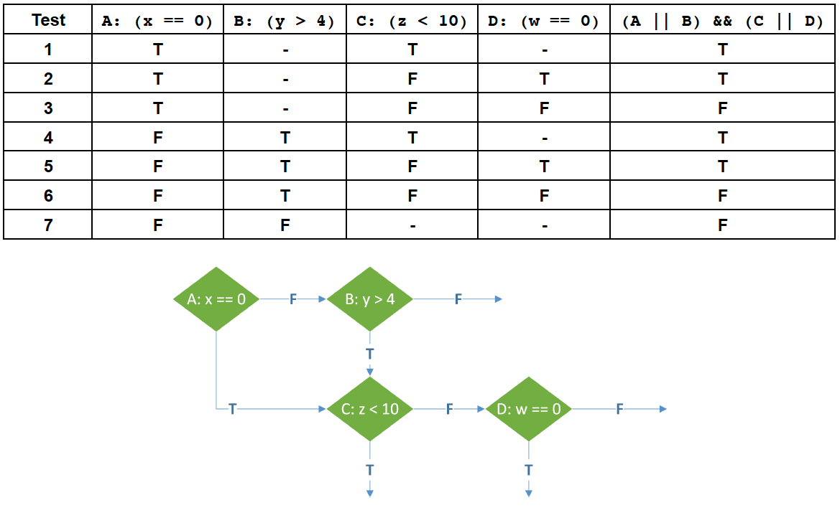
Example: Condition Coverage

Slide 45
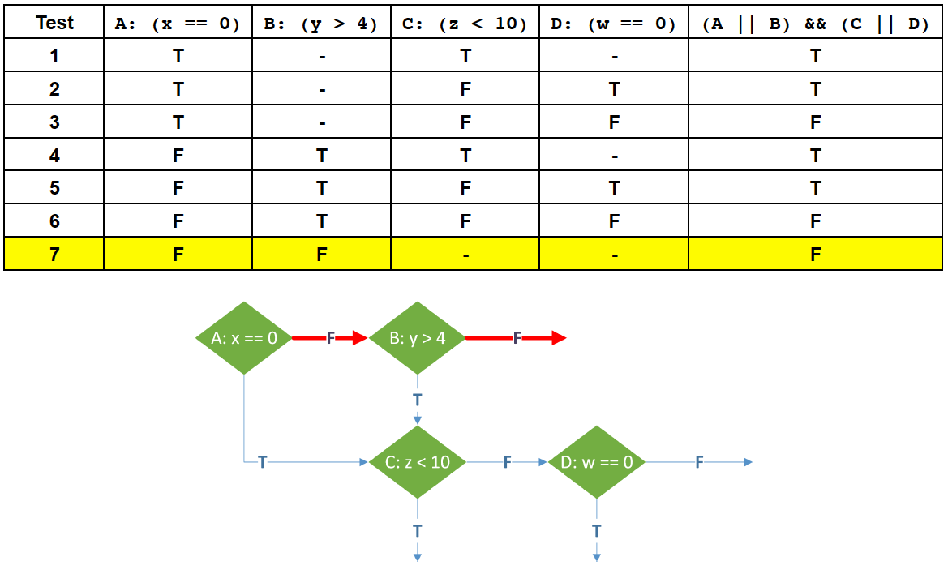
Example: Condition Coverage

Slide 46
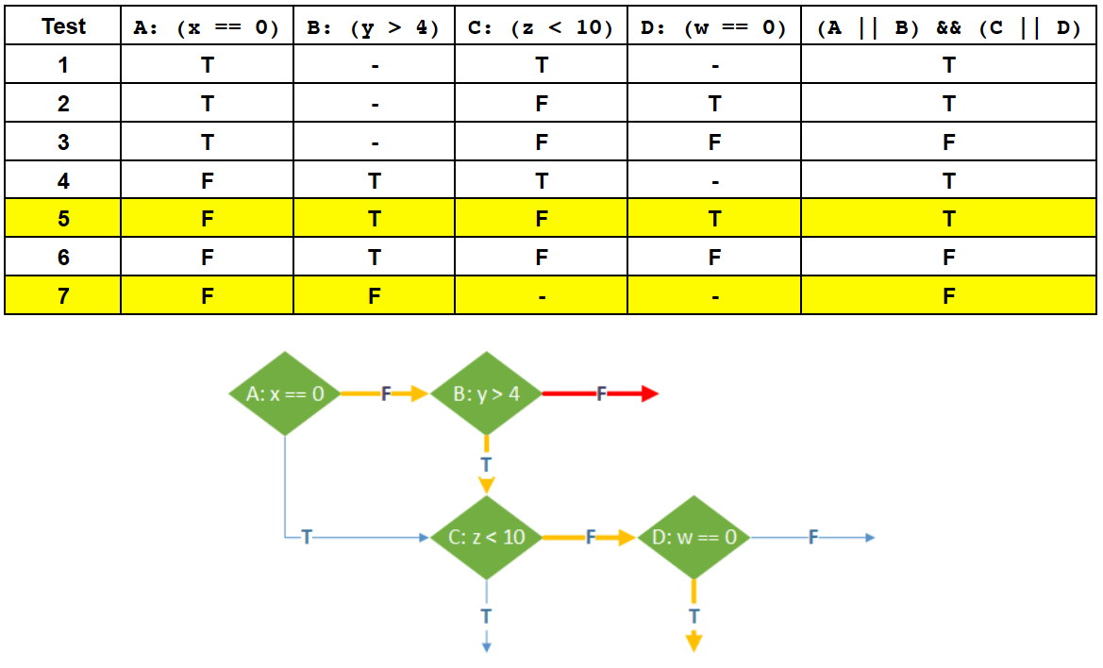
Example: Condition Coverage

Slide 47
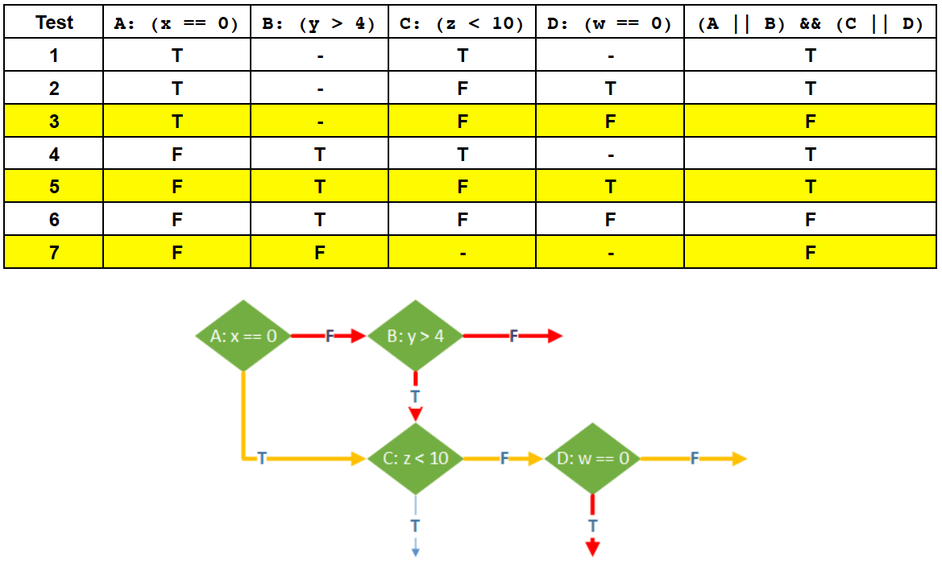
Example: Condition Coverage

Slide 48
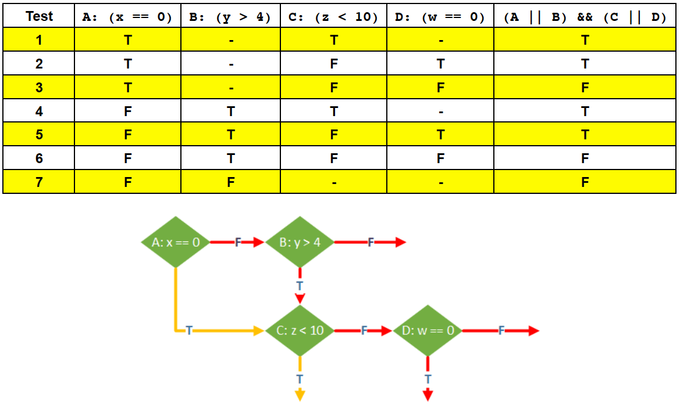
Example: Condition Coverage

Slide 49
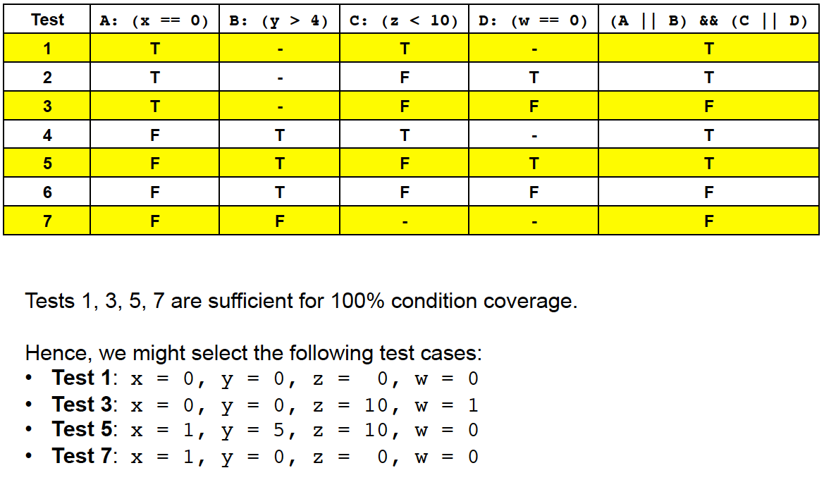
Example: Condition Coverage

Slide 50
Multiple Condition Coverage
• Condition coverage(C₂) says
– Every atomic condition must evaluate once to true and once to false
• Multiple condition coverage (C₃) says
– Every possible combination of atomic and composed predicates must evaluate once to true and once to false

Slide 51
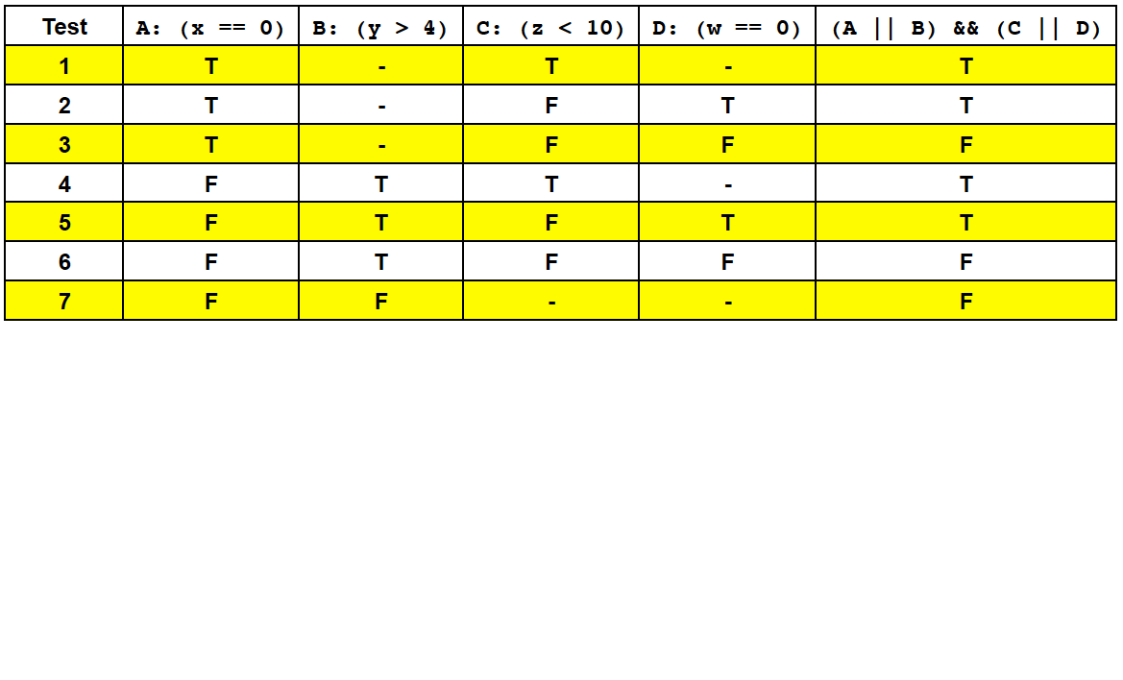
Ex: Condition Coverage

Slide 52
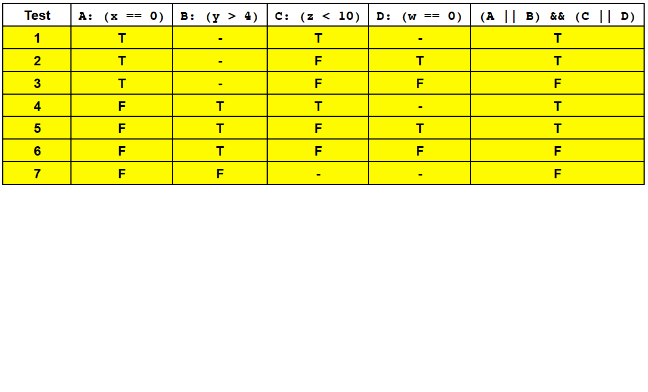
Ex: Multiple Condition Coverage

Slide 53
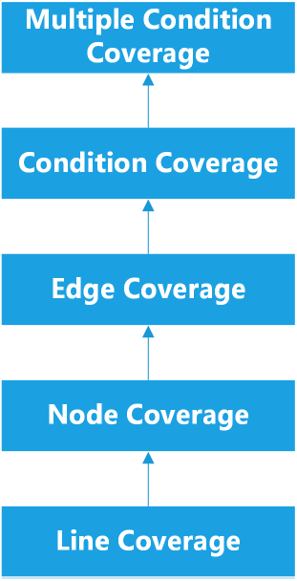
Multiple Condition Coverage
If we have achieved multiple condition coverage
– We must have evaluated every possible combination of each condition at least once to true and once to false
– Therefore, we must have evaluated each condition both ways
Multiple condition coverage is stronger than condition coverage

Slide 54
Path Coverage
• Path: sequence of nodes visited during an execution
• Path coverage is the strongest possible coverage measure
– 100% path coverage means that every possible path through the program flowchart has been followed
– For (non recursive) code without loops, this is achievable
– For code with non-deterministic loops:
• Each iteration of the loop adds an additional path
• For some code, we can iterate any number of times
– Eg. The number of iterations might depend on the size of an input
• For some code, 100% path coverage is not possible

Slide 55
Path Coverage - Example 1
• Recall the integer classification algorithm
• Four paths through the code are possible, covered by Test Suite:
1) x = 2
2) x = 1
3) x = -2
4) x = -1

Slide 56
Path Coverage - Example 2
Recall case converter
• Every char array evaluated may have different length
– Will follow different paths

Slide 57
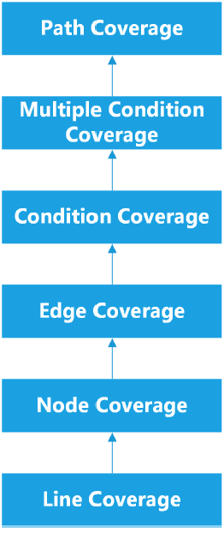
Path Coverage
If we have achieved 100% path coverage
– We must have evaluated every possible path through the program
– Therefore, we must have evaluated every possible combination of each condition at least once to true and once to false
Path coverage is stronger than multiple condition coverage

Slide 58
Testing Loops
• Path coverage for non-deterministic loops is impossible
– Most programs have non-deterministic loops with an arbitrary number of iterations
• e.g. a top-level loop in which we read a command and execute it
• For entire programs, we don't generally attempt 100% path coverage
• However, path coverage is still useful for small sections of code

Slide 59
Testing Loops
• We can't test all paths in programs with nondeterministic loops
– But, we want to do better than multiple condition coverage
• or might miss certain kinds of errors

Slide 60
Testing Loops
• Programmer may not consider what would happen if:
– The loop decision is false right from the start
– The loop decision is true once, and then false
• Sometimes, there is a maximum number of possible iterations for a loop (e.g. the loop might stop at the end of an array).
• Programmer may not consider what would happen if
– Loop decision is true max times
– Loop decision is true max-1 times

Slide 61
Testing Loops
It is therefore useful to write test cases which execute the loop:
– 0 times
– 1 time
– More than once
– max times (if applicable)
– max-1 times (if applicable)

